Slide 1
Machine Learning Initiative (central BALANCE SHEET data office POC)
48th World Continuous Auditing and Reporting Symposium
Natividad Pérez, Pablo Jiménez, Álvaro Barbero
September 24, 2020
STATISTICS AND INFORMATION SYSTEMS DEPARTMENTS

Slide 2
index
Introduction. Scope of the 2019 initiative
Prepared by IIC (Instituto de Ingeniería del Conocimiento)
  Anomalies score (outlier detection)
  Missing value imputation
Analysis of results
  Anomalies
  Missing value imputation
  Lessons learned and next steps
STATISTICS AND INFORMATION SYSTEMS

Slide 3
ÍNDICE
Introduction. Scope of the 2019 initiative
Prepared by IIC (Instituto de Ingeniería del Conocimiento)
  Anomalies score (outlier detection)
  Missing value imputation
Analysis of resultsResult analysis
  Anomalies
  Missing value imputation
Learned lessons and next steps
STATISTICS AND INFORMATION SYSTEMS

Slide 4
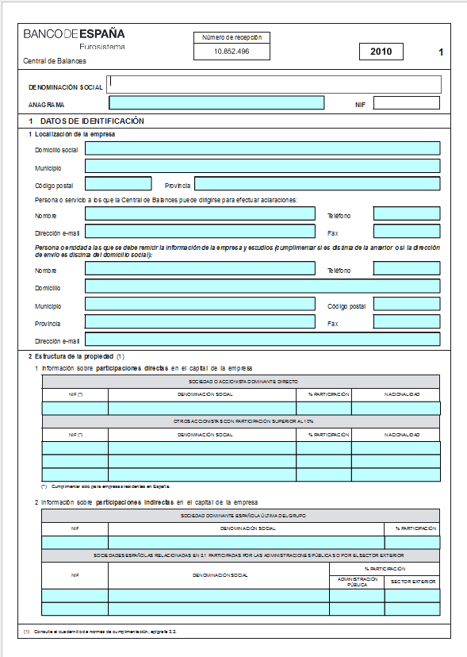
1. INTRODUCTION. SCOPE OF THE 2019 INITIATIVE
Central Balance Sheet Data Office case study
Questionnaires with accounting information of Spanish non-financial corporations:
10 exercises x 900,000 companies x 3,000 data.
Treated and classified by automatic processes.
20% are classified as unsuitable for study.
Can AI help us to improve these processes?
Find alternative patterns to classify the questionnaires: Case I. Anomaly detection.
Complete the omitted information: Case II. Value imputation.
STATISTICS AND INFORMATION SYSTEMS

Slide 5
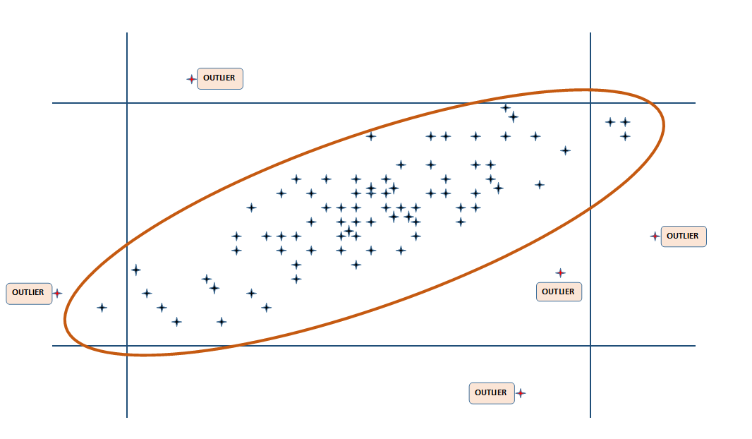
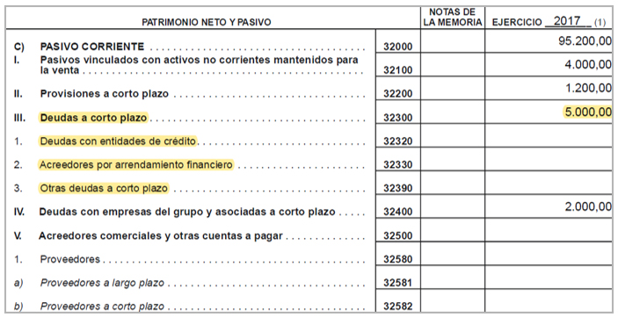
1. Introduction. Scope of the 2019 initiative
2019 POC objective
RECOVER QUESTIONNAIRES FOR STUDY
ANOMALIES SCORE
VALUE IMPUTATION in:
Anomaly index valuing n dimensions
(i) Most common imbalances and (ii) employment
STATISTICS AND INFORMATION SYSTEMS

Slide 6
1. INTRODUCTION. SCOPE OF THE 2019 INITIATIVE
Data pre-processing
Variable selection: 94 accounting keys+ employment key+ 2 fields of activity sector (Sector and Great sector).
Accounting standardisation: Divide the Profit and Loss fields by net revenues. The Balance between Total Assets.
Generate new variables: Averages of each value in the last 2-5 years, number of declared sectors, Company age…
Separate questionnaires according to their quality:
  Perfect (5.323.000)
  Low quality (476.000)
  Missing (469.000)
STATISTICS AND INFORMATION SYSTEMS

Slide 7
INDEX
Second point
Introduction. Scope of the 2019 initiative
Prepared by IIC (Instituto de Ingeniería del Conocimiento)
  Anomaly score (outlier detection)
  Missing value imputation
Analysis of results
  Anomalies
  Missing value imputation
Lessons learned and next steps
STATISTICS AND INFORMATION SYSTEMS

Slide 8
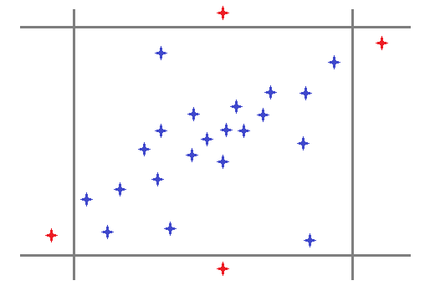

2.I. AnomalIES SCORE
Outlier detection
ANOMALY SCORE
Anomaly score calculation [0,1] vs. Outlier detection (Yes/No).
Algorithm used: Isolation Forest.
STATISTICS AND INFORMATION SYSTEMS

Slide 9
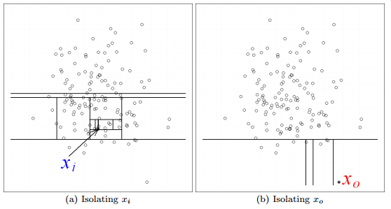
2.I. ANOMALIES SCORE
Algorithm
ISOLATION FOREST
Anomalous instances are easily isolated by random divisions of space.
Missolation Forest: custom modification of Isolation Forest algorithm to allow estimation of anomaly score when missing values are present in the data.
Liu et al – Isolation Forest
STATISTICS AND INFORMATION SYSTEMS

Slide 10


2.I. ANOMALIES SCORE
Anomaly scoring distributions
Study: not publishable but not anomalous
Study: publishable but anomalous
STATISTICS AND INFORMATION SYSTEMS

Slide 11

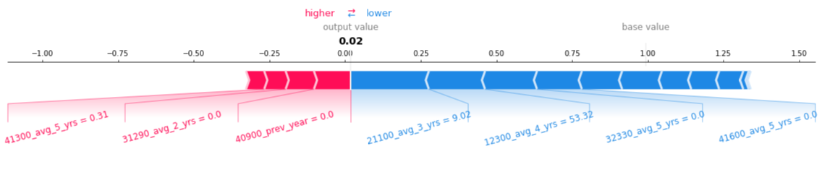
2.I. ANOMALIES SCORE
Explainability: Information offered by IIC to open the black box
Shapley values: in game theory, the Shapley (mathematician and economist 1923 -2016, Nobel prize in Economics 2012) value is a method of distributing wealth among the players of a cooperative game, in order to distribute the total benefit generated by the coalition of all players.
The distribution is guaranteed to be fair: each player receives a contribution proportional to the value they add to the coalition.
It means that the variable “average of the last 3 years of the key 21100”, having a value of 9.2, reduces the score by 0.26 points approx.
STATISTICS AND INFORMATION SYSTEMS

Slide 12
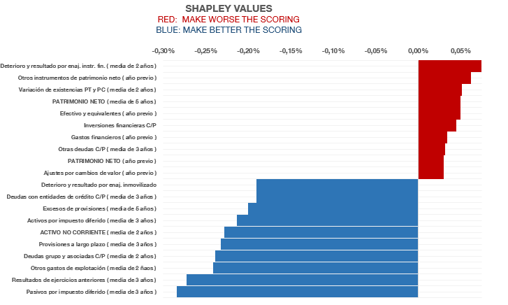
2.I. ANOMALIES SCORE
Explainability: Information offered by IIC to open the black box
Shapley values are additive, which allow us to compute the global influence of a variable for the whole dataset or for a subset of the data.
ACCOUNTS
STATISTICS AND INFORMATION SYSTEMS

Slide 13
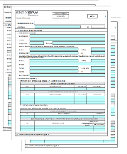
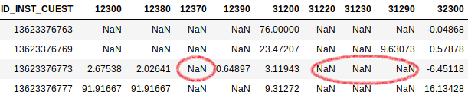
2.II. VALUE IMPUTATION
Training, drilling and predictions
TRAINED
MODEL
80%
TRAIN
20%
TEST
PERFECT
PREDICTION
DRILLING
MISSING
STATISTICS AND INFORMATION SYSTEMS

Slide 14
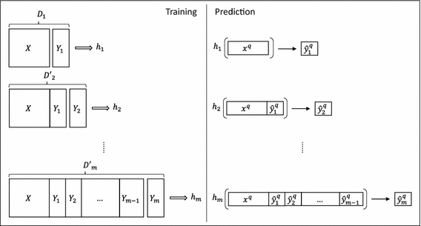
2.II. VALUE IMPUTATION
Method: ERC
Ensemble of Regressor Chains (ERC): Build several regression models on an incremental basis. Each model predicts a variable that is then used to train the next model.
Train: 240,000
Test: 60,000
Regression model:
Random forests 1,000 trees
Not a widely-known method: custom implementation developed for this project.
Accurate imputations, high computational requirements.
The order of prediction of the variables (string) theoretically affects the result, giving greater weight to the first variables chosen. 5 random strings are tested.
STATISTICS AND INFORMATION SYSTEMS

Slide 15
INDEX
Third point
Introduction. Scope of the 2019 initiative
Prepared by IIC (Instituto de Ingeniería del Conocimiento)
  Anomalies score (outlier detection)
  Missing value imputation
Analysis of results
  Anomalies
  Missing value imputation
Lessons learned and next steps
STATISTICS AND INFORMATION SYSTEMS

Slide 16
ANOMALIES. Scoring IIC vs CB quality: Data distribution
3.I. ANALYSIS OF RESULTS
False positives? Analyze to detect possible improvements in our filtering systems.
False negatives? Analyse whether it is necessary to relax our filtering systems
94% of the questionnaires are concentrated in a range of anomaly between 0 and 0.2
QUALITY OF CBB QUESTIONNAIRES 2017
Scoring IIC (0=Right; 1=Wrong) | PERFECT | NOT PERFECT | TOTAL | % Total accumulated
0-0,1 | 411.973 | 41.626 | 453.599 | 71,3%
0,1-0,2 | 118.439 | 28.942 | 147.381 | 94,4%
0,2-0,3 | 20.380 | 5.404 | 25.784 | 98,5%
0,3-0,4 | 5.154 | 1.377 | 6.531 | 99,5%
>0,4 | 2.299 | 853 | 3.152 | 100,0%
TOTAL | 558.245 | 78.202 | 636.447
CdB CRITERIA:
In general there is harmony between the results of the ML models and those obtained with deterministic criteria of CB
STATISTICS AND INFORMATION SYSTEMS

Slide 17

Anomalies. Why should we trust the score?
3.I. ANALYSIS OF RESULTS
In summary:
Accepting this score… | …we win or lose companies | …giving up on these… | …and including these…
0.1 | -104,646 | -146,272 | 41,626
0.2 | 42,735 | -27,833 | 70,568
0.3 | 68,519 | -7,453 | 75,972
0.4 | 75,050 | -2,299 | 77,349
STATISTICS AND INFORMATION SYSTEMS

Slide 18
INDEX
3.2 point
Introduction. Scope of the 2019 initiative
Prepared by IIC (Instituto de Ingeniería del Conocimiento)
  Anomalies score (outlier detection)
  Missing value imputation
Analysis of results
  Anomalies
  Missing value imputation
Lessons learned and next steps
STATISTICS AND INFORMATION SYSTEMS

Slide 19
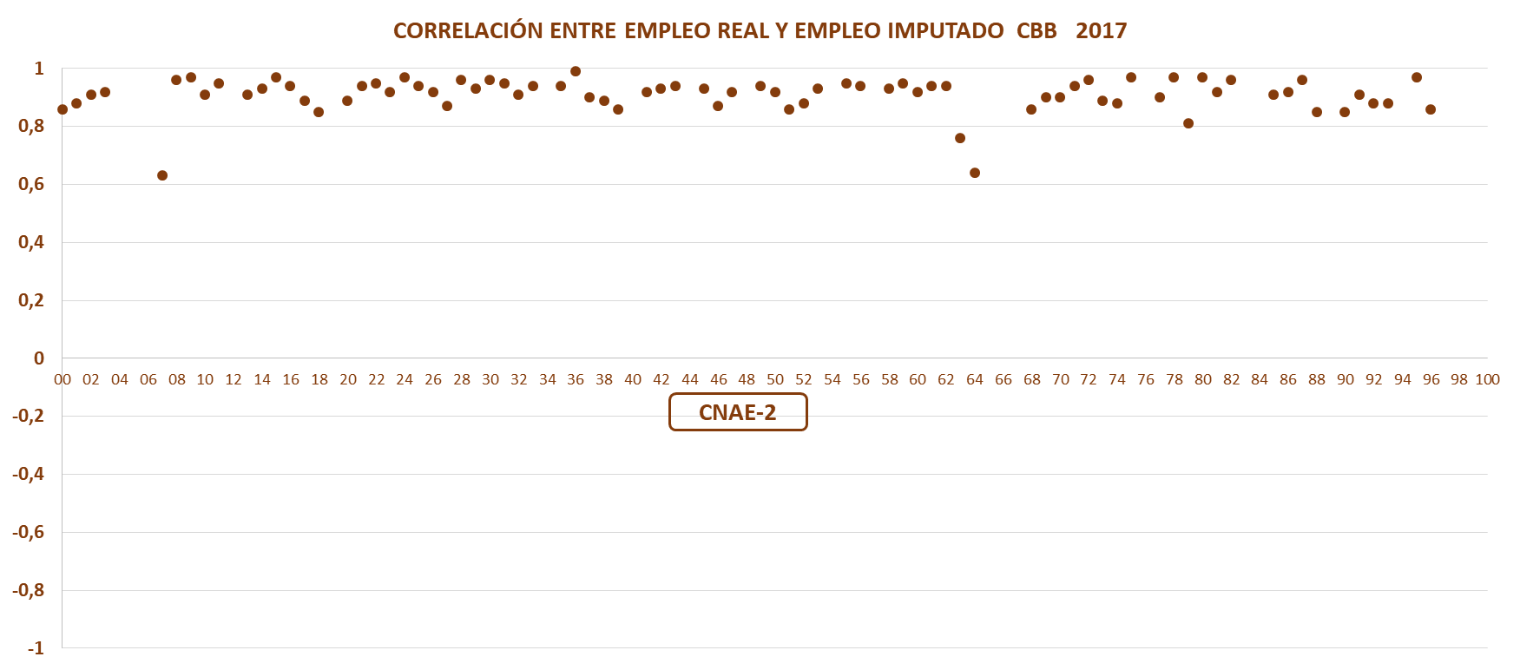

Correlations: Imputed employment vs real employment
3.II. ANALYSIS OF RESULTS
SECTOR
STATISTICS AND INFORMATION SYSTEMS

Slide 20
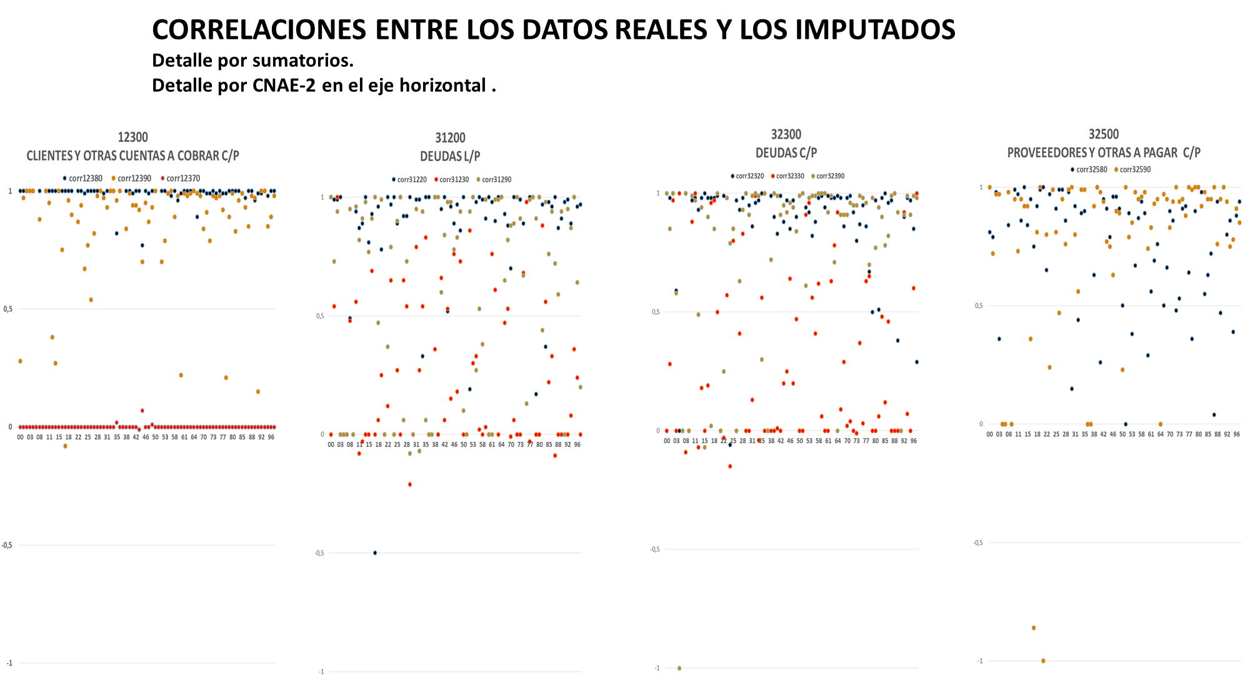


3.II. ANALYSIS OF RESULTS
Correlations between real and imputed data
  Detail by sector on the horizontal axis.
CLIENTS
SHORT TERM DEBT
LONG TERM DEBT
SUPPLIERS
Clients (12380): correlation very close to 1
Shareholders for required disbursements (12390): correlation close to 0
High correlations in debts with credit institutions (blue). Low for creditors for leasing (orange)
Less amount of imputed data in suppliers than in clients. Worse correlation in suppliers than in clients
STATISTICS AND INFORMATION SYSTEMS

Slide 21
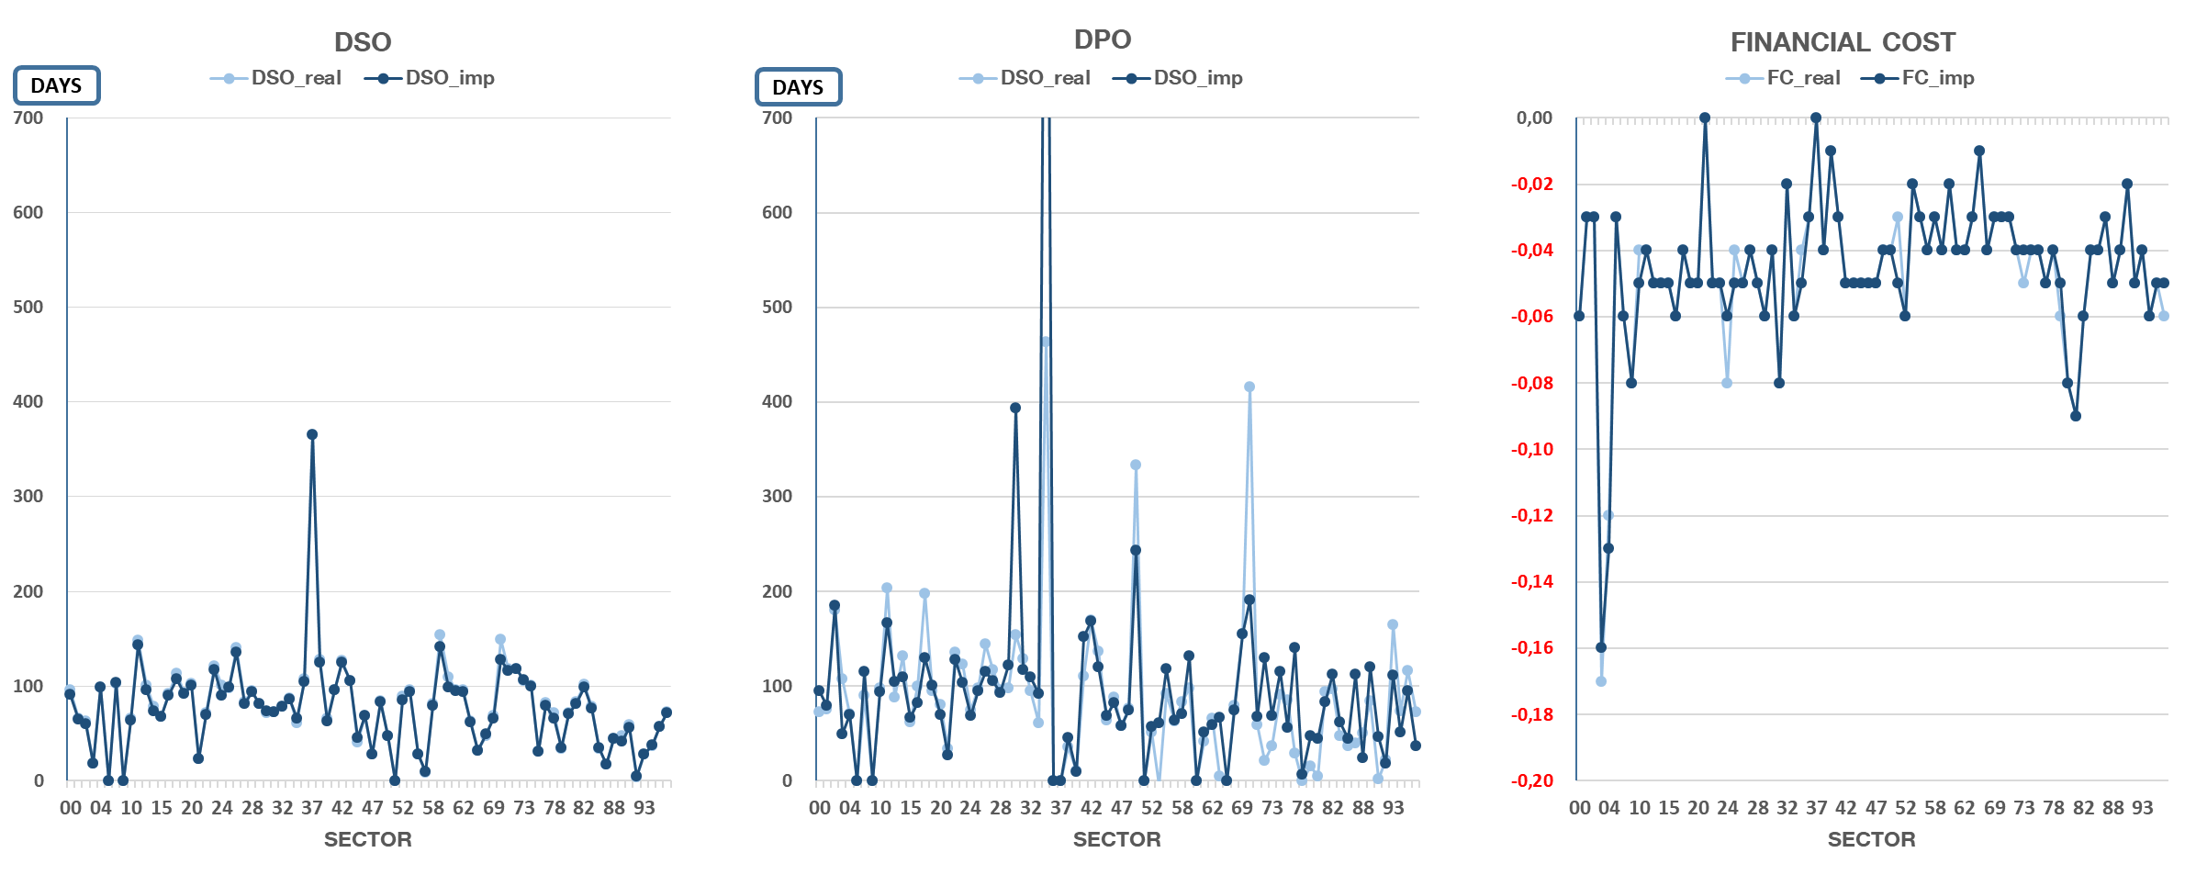
3.II. ANALYSIS OF RESULTS
IMPUTATIONS: Days payable and sales outstanding by activity sector
The correlations are acceptable for DSO and financial cost, but are lower for DPO, perhaps because fewer imputations have been made in the supplier key.
STATISTICS AND INFORMATION SYSTEMS

Slide 22
CONTENTS
Fourth point
Introduction. Scope of the 2019 initiative
Prepared by IIC (Instituto de Ingeniería del Conocimiento)
  Anomalies score (outlier detection)
  Missing value imputations
Analysis of results
  Anomalies
  Missing value imputations
Lessons learned and next steps
STATISTICS AND INFORMATION SYSTEMS

Slide 23


4. LESSONS LEARNED AND NEXT STEPS
What does 2019 POC improve on the 2018 pilot programme?
4. LECCIONES APRENDIDAS Y SIGUIENTES PASOS
BIGGER SAMPLE
VARIABLE SELECTION
Reduce the complexity of the problem by eliminating non-significant variables for the business and dependent variables.
VARIABLE VALUES
Data normalisation (avoid distorsions due to Company size ).
More accounting exercises.
Distinguish between uninformed values and zeros.
EXPERT KNOWLEDGE
The need to include accounting experts’ knowledge in the design of algorithms.
More companies.
Due to computer capacity constraints we have not trained with all the selected data.
But the number of variables could be reduced further (e.g. moving averages previous years )
Done at all POC phases: data selection, standardisation, results evaluation…
STATISTICS AND INFORMATION SYSTEMS

Slide 24

4. LESSONS LEARNED AND NEXT STEPS
Next steps
To validate the anomaly score it is necessary:
  To have Shapley rate for custom aggregates to business needs (certain sectors, size,…)
To validate the imputations it is necessary:
  To dispose of Shapley rate for imputations and not only for anomalies
  To review the perforated pattern in the test set (example: key of suppliers with little imputed data)
  To try to repeat the allocations after the elimination of anomalous questionnaires
In short, more analysis…
STATISTICS AND INFORMATION SYSTEMS

Slide 25
THANK YOU FOR YOUR ATTENTION
STATISTICS AND INFORMATION SYSTEMS

Slide 26
3.I. ANALYSIS OF RESULTS
ANOMALIES. Building the confusion matrix. Scoring IIC vs CBSO quality
QUALITY OF CBSO QUESTIONNAIRES 2017
Scoring IIC (0=Right; 1=Wrong) | PERFECT | IMPERFECT | TOTAL | % Total accumulated
0-0,1 | 411.973 | 41.626 | 453.599 | 71,3%
0,1-0,2 | 118.439 | 28.942 | 147.381 | 94,4%
0,2-0,3 | 20.380 | 5.404 | 25.784 | 98,5%
0,3-0,4 | 5.154 | 1.377 | 6.531 | 99,5%
>0,4 | 2.299 | 853 | 3.152 | 100,0%
TOTAL | 558.245 | 78.202 | 636.447
Example if CBSO accepts an score up to 0.1:
CBSO gains: 41,626
CBSO loses: 558,245 - 411,973= 146,272
RESULT: net loss = 104,646
SUMMARIZING…
Accepting up to this score… | …the net gain or loss of observations is | …losing these… | …and gaining these…
0.1 | -104,646 | -146,272 | 41,626
0.2 | 42,735 | -27,833 | 70,568
0.3 | 68,519 | -7,453 | 75,972
0.4 | 75,050 | -2,299 | 77,349
STATISTICS AND INFORMATION SYSTEMS

Slide 27
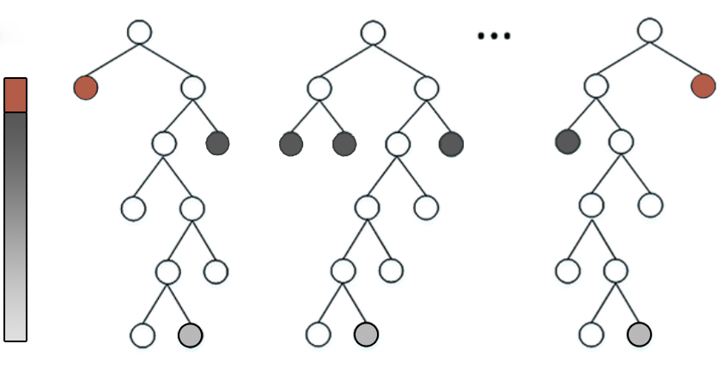
2.I. ANOMALIES SCORE
Algorithm
IForest
Scores
ITree
Outlier
Normal uncommon samples
0.5
Normal common samples
Training with 5,000 trees and all the perfect questionnaires: 5.300.000
Evaluation on the basis of the perfect, low quality and missing questionnaires of 2017.
MissolationForest: custom modification of IsolationForest algorithm to allow estimation of depth (score) when missing values are present in the data.
STATISTICS AND INFORMATION SYSTEMS

Slide 28
3.I. ANALYSIS OF RESULTS
ANOMALIES. XAI (Explainable Artificial Intelligence): Explaining the black box
CONTRIBUTIONS TO THE ANOMALY INDEX: SHAPLEY RATIOS
Indicate which keys have contributed most to the anomaly index
It means that the variable “average of the last 3 years of the key 21100”, having a value of 9.2, reduces the score by 0.26 points approx.
Individual interpretation: not very useful in the reviewed cases
Additive property to analyse a specific node
STATISTICS AND INFORMATION SYSTEMS

Slide 29
2.I. ANOMALIES SCORE
Missolation Forest
MissolationForest
Scores
ITree
Outlier
Normal uncommon samples
?
0.5
Estimate expected depth
?
Normal common samples
Estimate expected depth
Estimate expected depth
Custom modification of IsolationForest algorithm to allow estimation of depth (score) when missing values are present in the data.
STATISTICS AND INFORMATION SYSTEMS

Slide 30
2.I. ANOMALIES SCORE
Main challenges
Challenges:
  Avoid biases (size, sector…) Different standardisations.
  Incomplete questionnaires Missolation Forest.
  Difficulty evaluating results The confusion matrix is studied.
  Result “explainability” Shapley values.
STATISTICS AND INFORMATION SYSTEMS

Slide 31
2.I. ANOMALIES SCORE
Explainability: Information offered by IIC to open the black box
Shapley values: In game theory, the Shapley (mathematician and economist 1923 -2016, Nobel prize in Economics 2012) value is a method of distributing wealth among the players of a cooperative game, in order to distribute the total benefit generated by the coalition of all players.
The Shapley distribution is guaranteed to be:
Efficient: all benefit is shared among all players, no benefit is lost.
Symmetric: players with equal contribution receive equal benefit.
Null players: is a player contributes nothing, their benefit is 0.
Additivity: if the total benefits function decomposes linearly, Shapley values also decompose in the same way.
The Shapley values are the only distribution meeting these four fairness criteria.
STATISTICS AND INFORMATION SYSTEMS

Slide 32
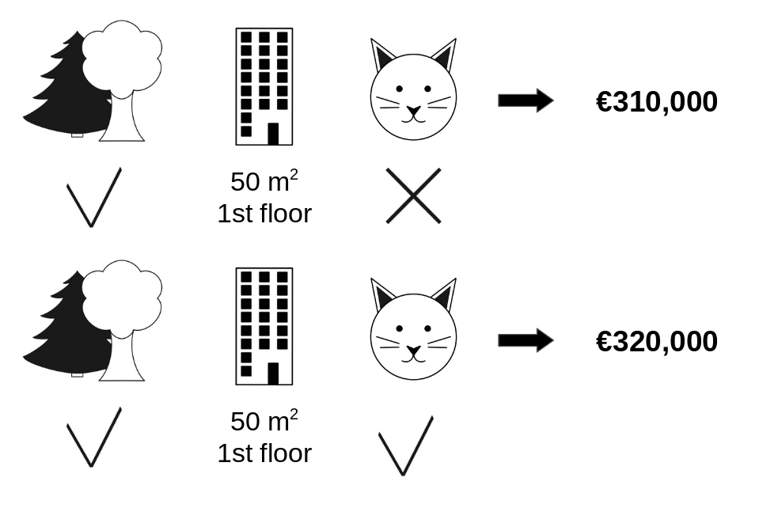
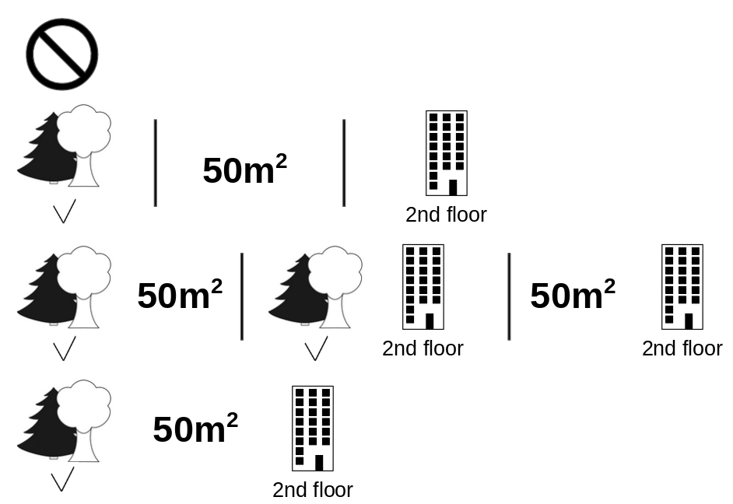
2.I. ANOMALIES SCORE
Explainability: Information offered by IIC to open the black box
Simple case
Possible coalitions
Computationally expensive, even with approximation methods.
High explainability
STATISTICS AND INFORMATION SYSTEMS

Slide 33
2.II. VALUE ALLOCATION
Method 1: VAE
Variational AutoEncoder (VAE)
Automatic reduction of the dimensionality based on the main component technique (12 components).
Train: 2,400,000
Test: 600,000
Absolute value of the differences between real and allocated values.
Worst result among the tested algorithms despite training with many more instances.
STATISTICS AND INFORMATION SYSTEMS

Slide 34
2.II. VALUE ALLOCATION
Method 2: MICE
Multivariate Imputation by Chained Equations (MICE)
Train: 80,000
Test: 20,000
Absolute value of the differences between real and allocated values.
Better than VAE. Great heterogeneity by key.
Simulation with synthetic data (Normal, gamma and exponential distributions)
MICE is very sensitive to the distribution of the original data.
STATISTICS AND INFORMATION SYSTEMS

Slide 35
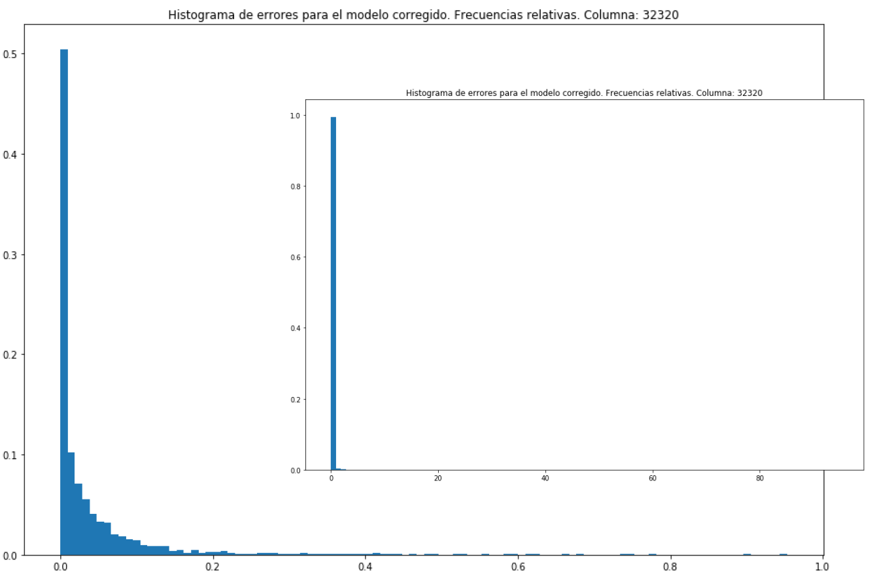

2.II. VALUE ALLOCATION
ERC results: IIC give us these histograms
Error normalised by Total Assets
$$\frac{\left|\hat{y}−y\right|}{C10000}$$
STATISTICS AND INFORMATION SYSTEMS

Slide 36


4. LESSONS LEARNED AND NEXT STEPS
LARGER SAMPLE
VARIABLE SELECTION
VARIABLE VALUES
EXPERT KNOWLEDGE
Reduce complexity of the problem by eliminating non-significant variables for the business and dependent variables
More companies
More accounting exercises
Due to computer capacity constraints we have not trained with all the selected data
But the number of variables could be reduced further (e.g. moving averages previous years)
The need to include accounting experts’ knowledge in the design of algorithms
Data normalisation (avoid distortions due to company size)
Distinguish between uninformed values and zeroes
Done at all POC phases: data selection, standardisation, results evaluation…
STATISTICS AND INFORMATION SYSTEMS

